Slide 1

Next-Gen Wealth Management: A Cloud-Native Platform for Secure, Scalable Private Banking

Slide 2
Wealth management platform
"Delivering private wealth management experiences through cloud-native innovation"
This demo showcases an end-to-end wealth management platform built with Spring Boot, React, and AWS, addressing key challenges in portfolio management, client-advisor collaboration, and regulatory compliance. The solution highlights my expertise in cloud migration, microservices architecture, and financial system security – directly applicable to JPMorgan's Global Private Banking Technology initiatives.
By Girish(吉里)
System Analyst(Cloud Migration Specialist) | IT Solution Consultant | Tech Lead

Slide 3
Business Requirements
Scalable , Secure and High-Quality Code Development
Develop and maintain secure, high-quality production code using Spring (Java) or React (JS/TS), mapstruct, Netflix DGS, GraphQL
Ensure code adheres to architecture and design patterns and meets all design constraints.
Architecture
HLD
LLD
UI design
Data Design
Coding Standards and setup
Development roadmap
Demo
Report & Monitoring
Any questions?
Key Features:
Role-based dashboards (Client/Advisor/Compliance)
AI-driven investment alerts
Audit trails for FINRA compliance
"High-net-worth clients demand real-time portfolio visibility with military-grade security"

Slide 4
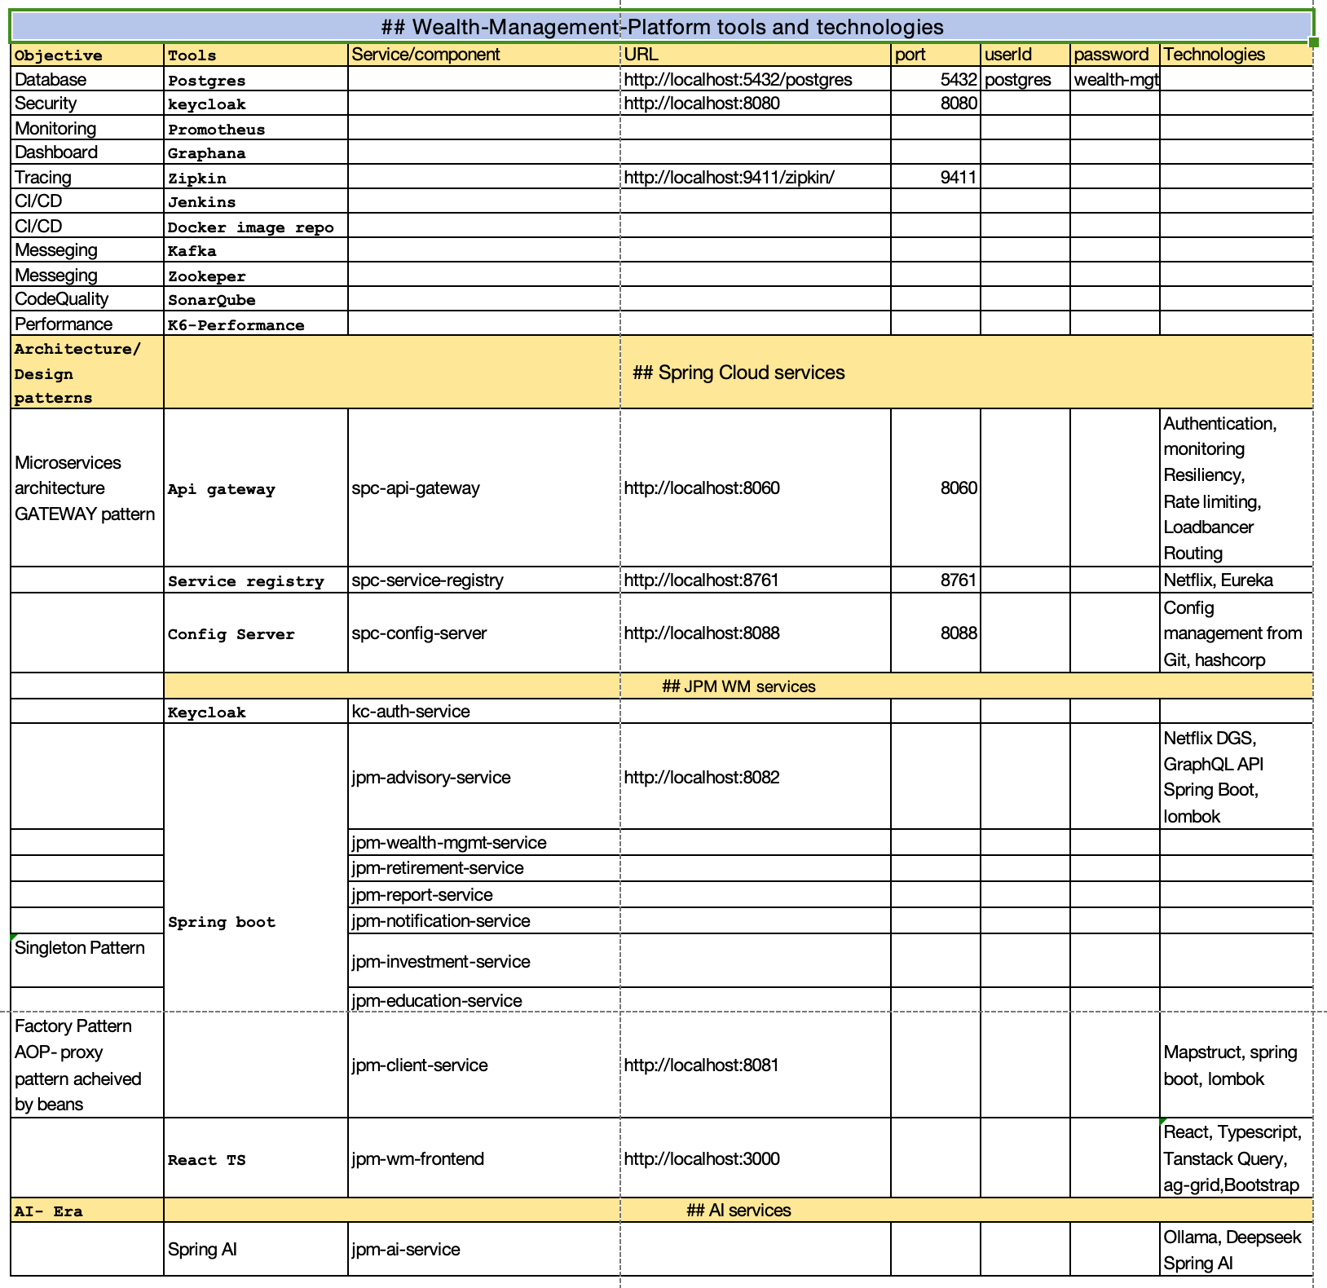
Development roadmap
Requirements, Analysis, architecture Design(High level, low level), UI design, database design, deployment design, Testing design, Scalability and data security test

Slide 5
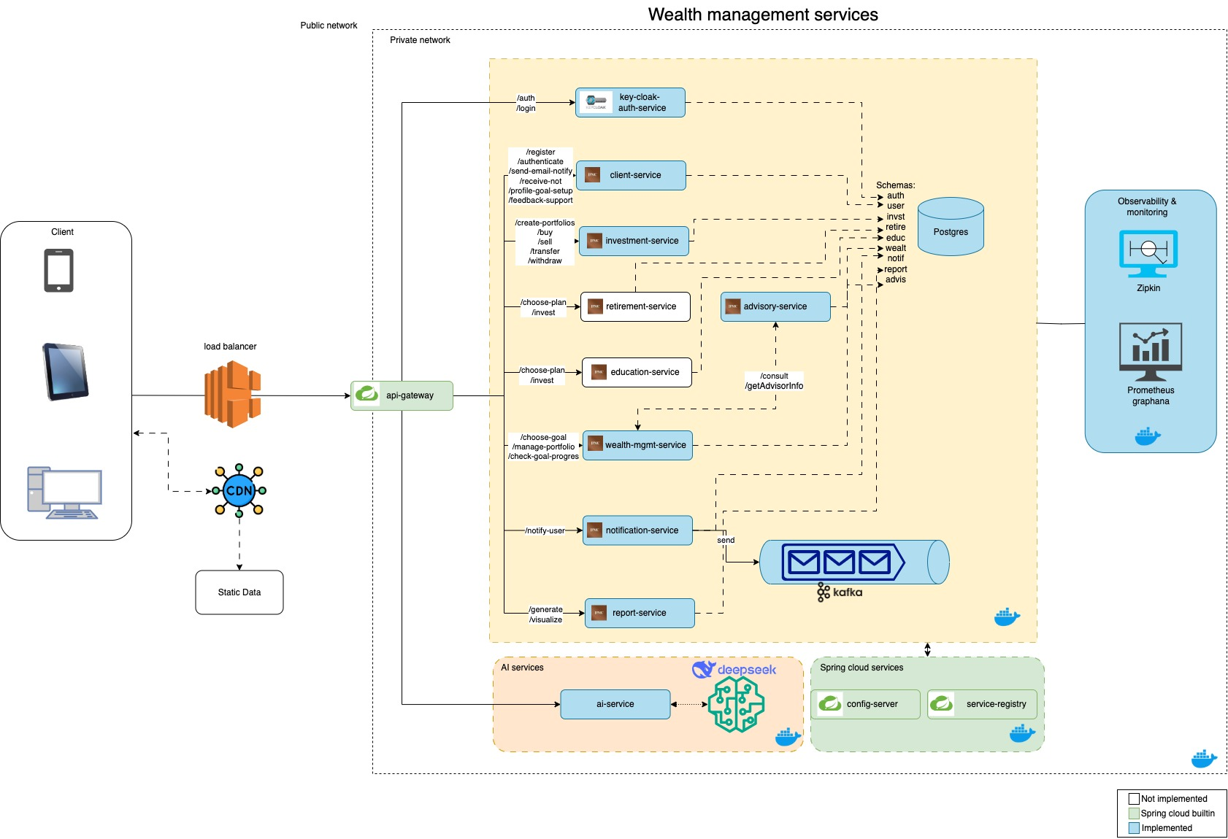
Architecture

Slide 6
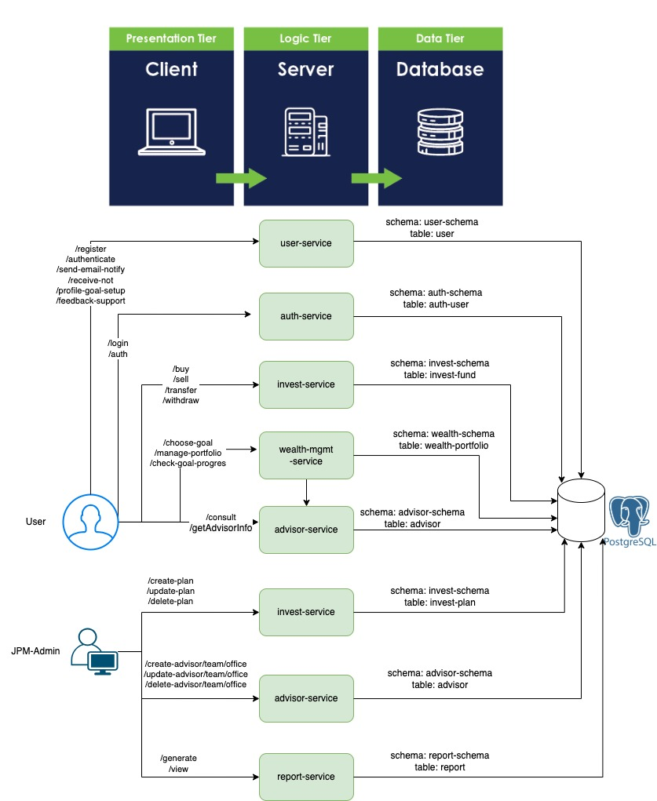
Three tier architecture
User activity with API mapping
diagram

Slide 7
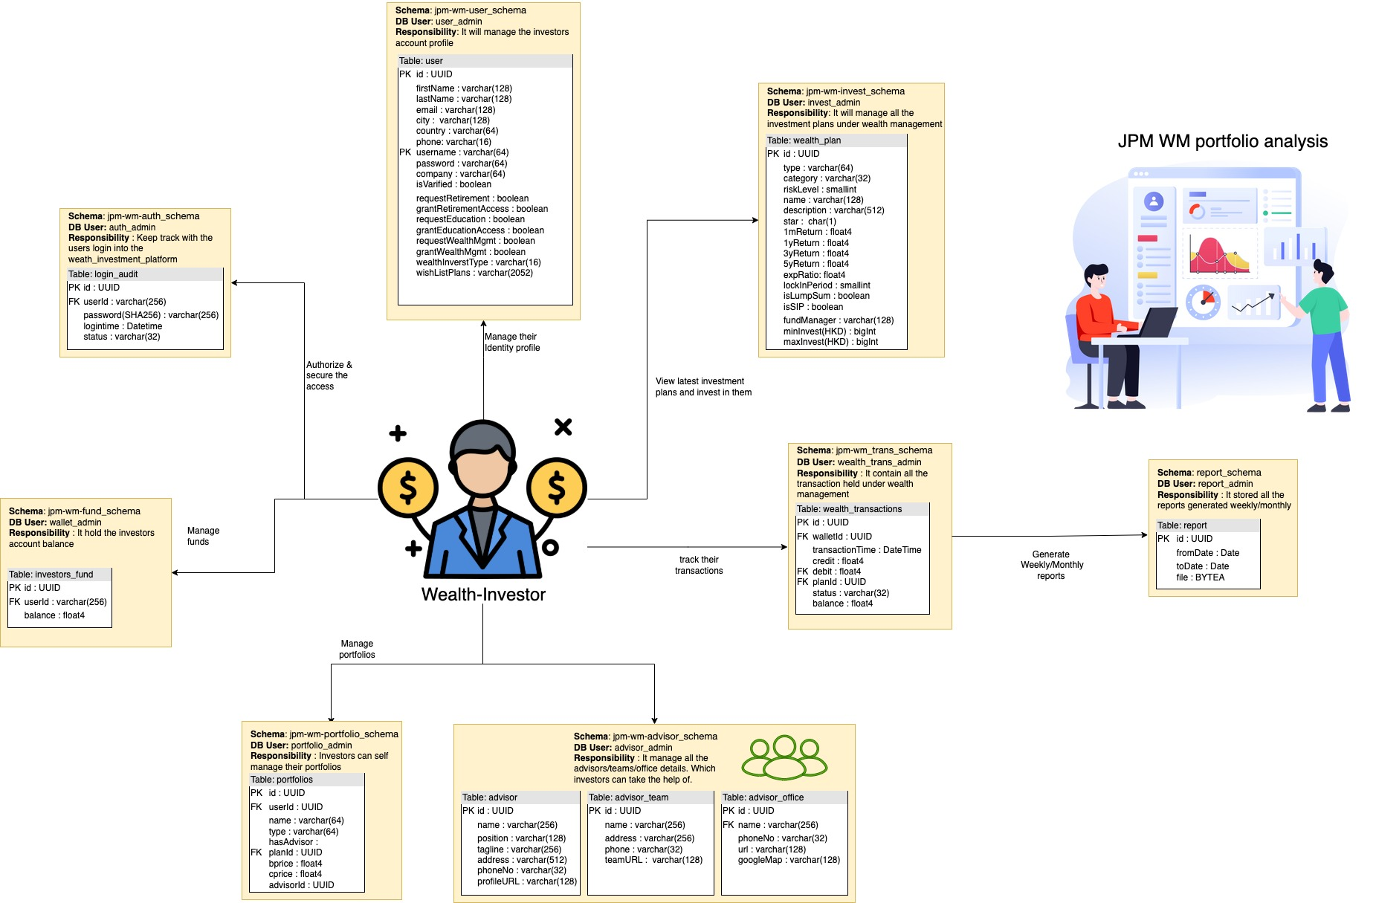
Database design

Slide 8
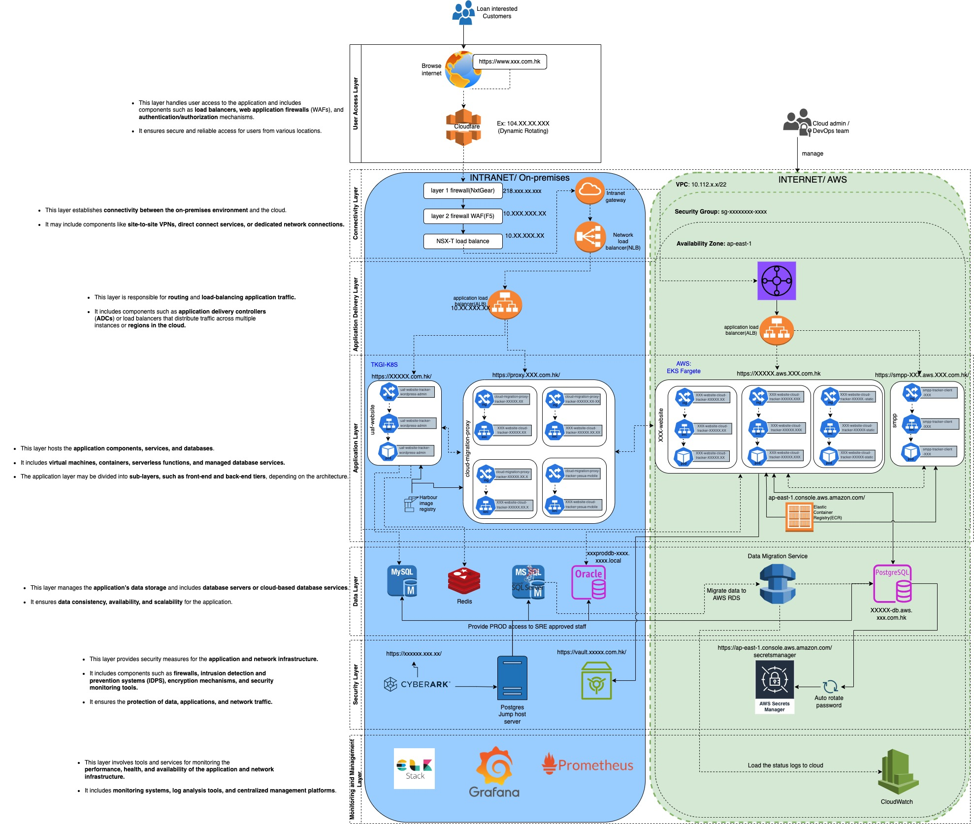
Infrastructure
Cloud

Slide 9
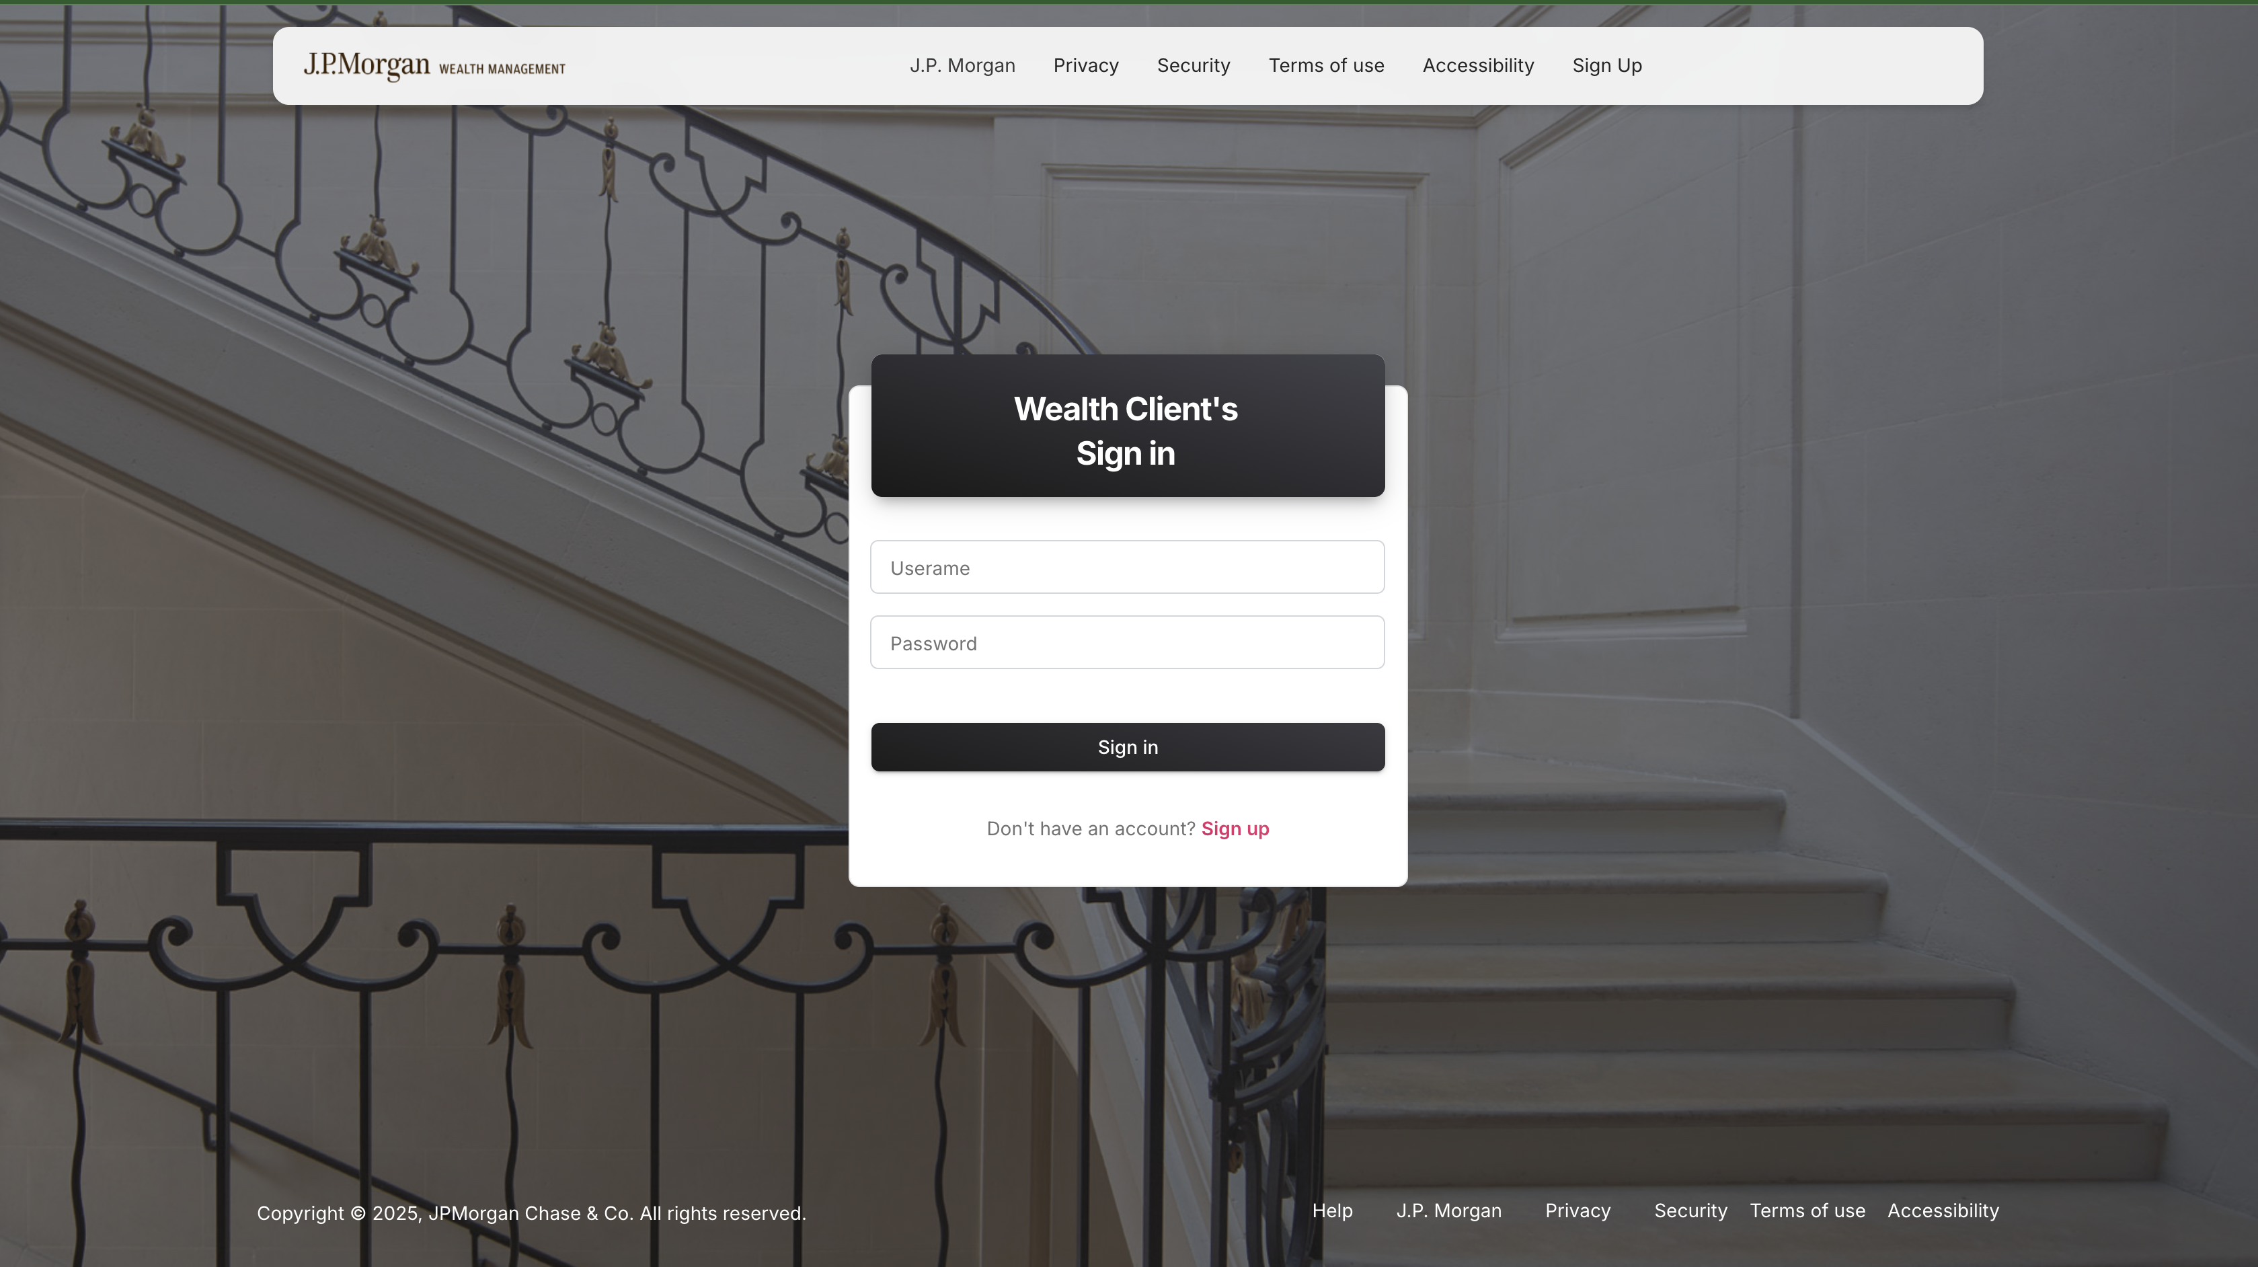
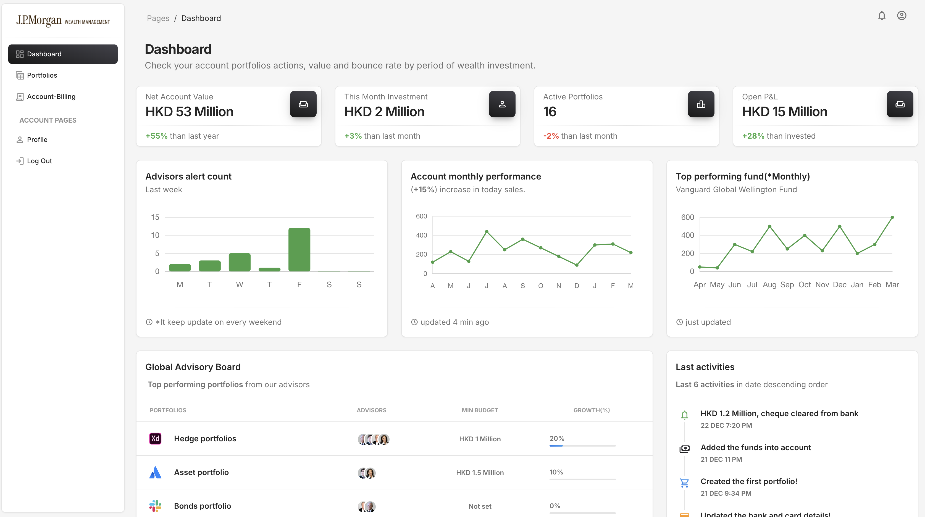
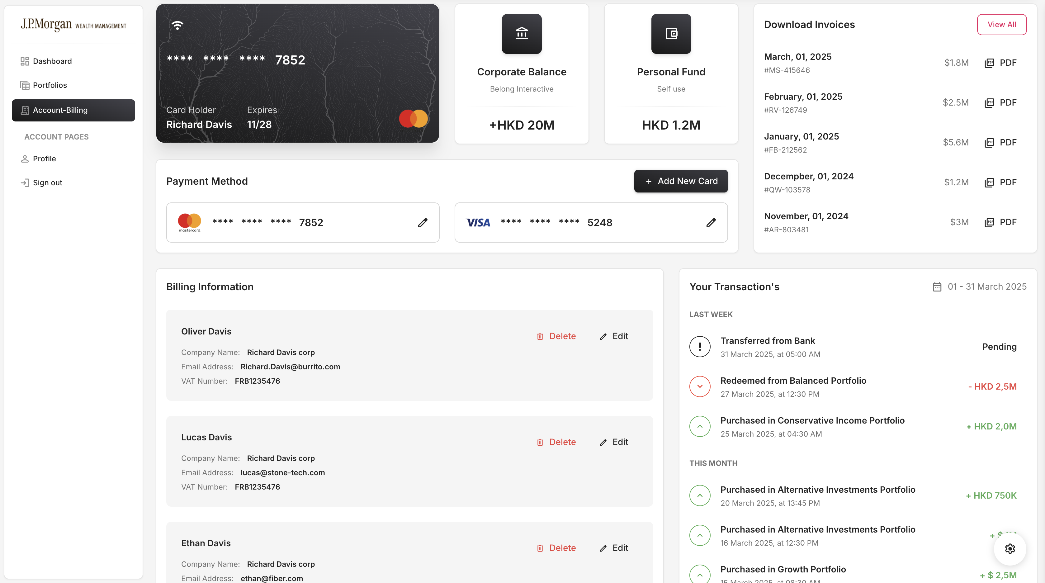
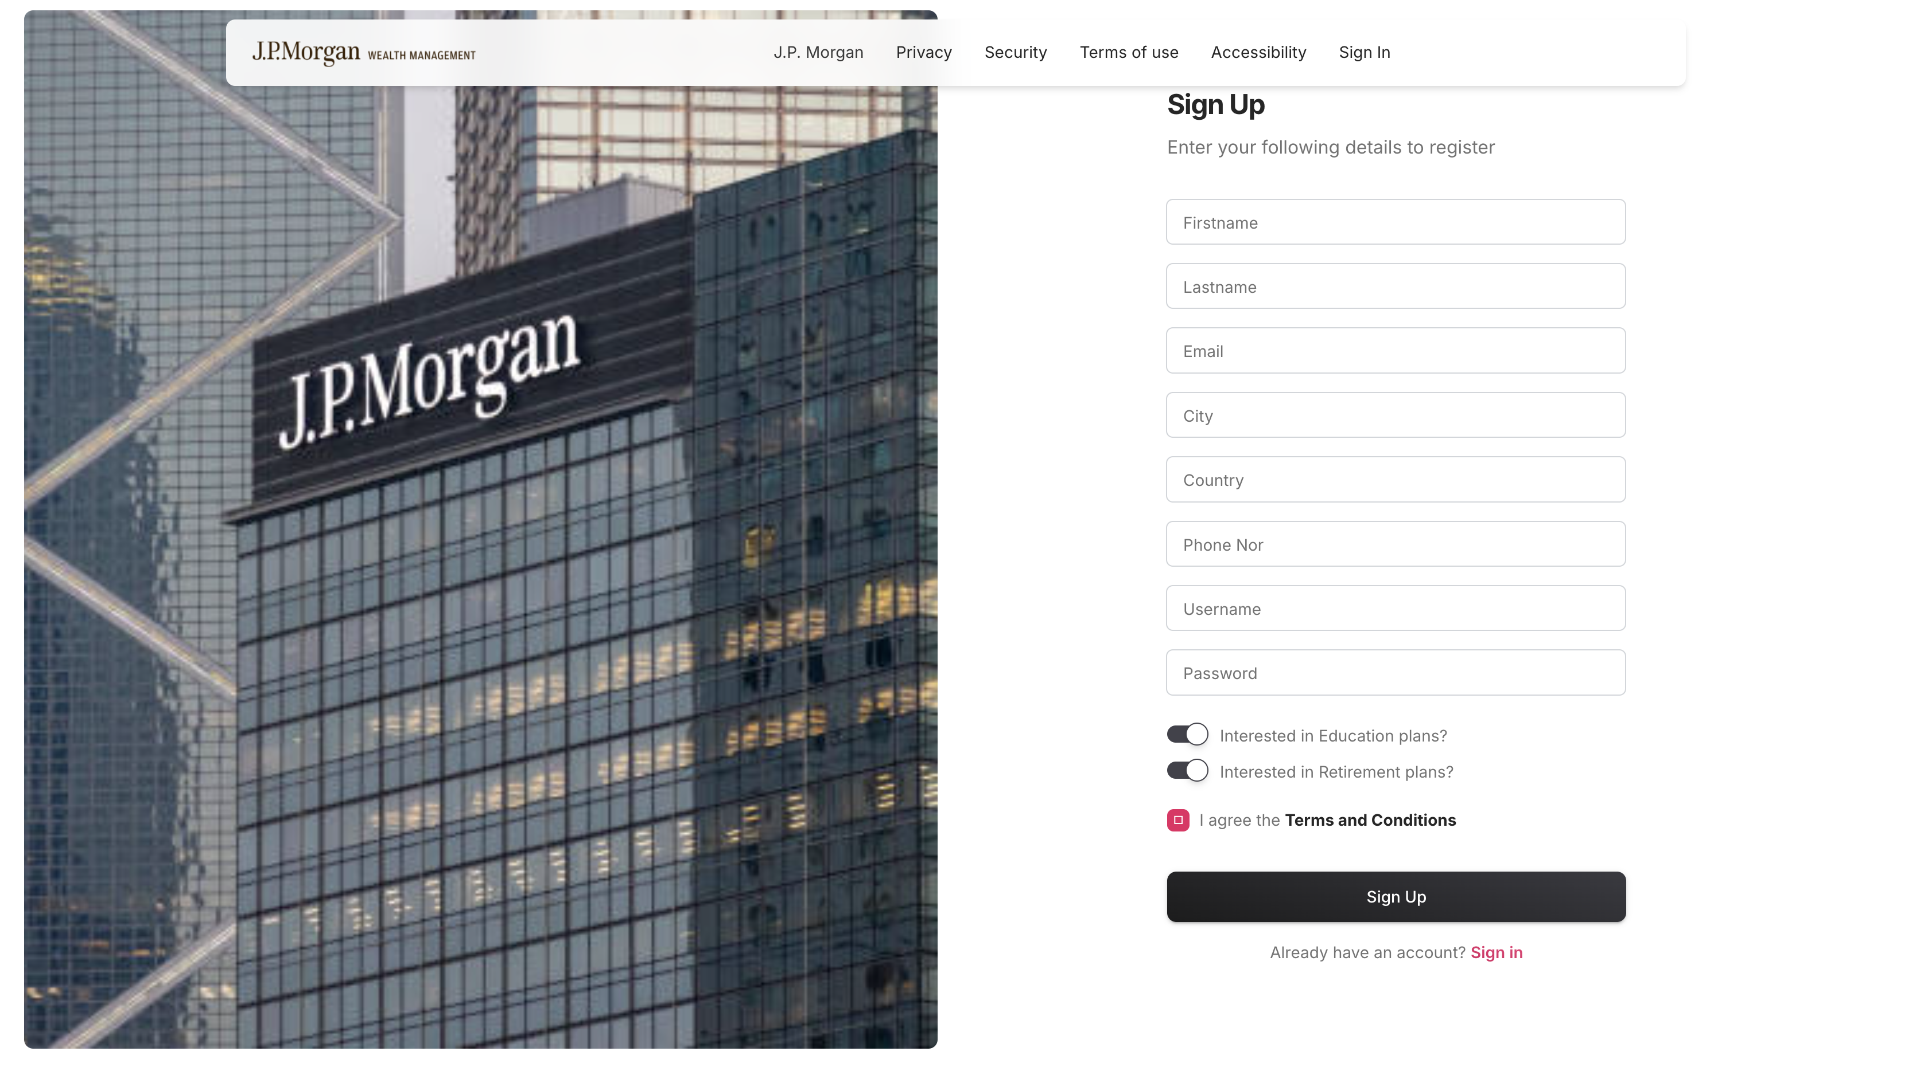
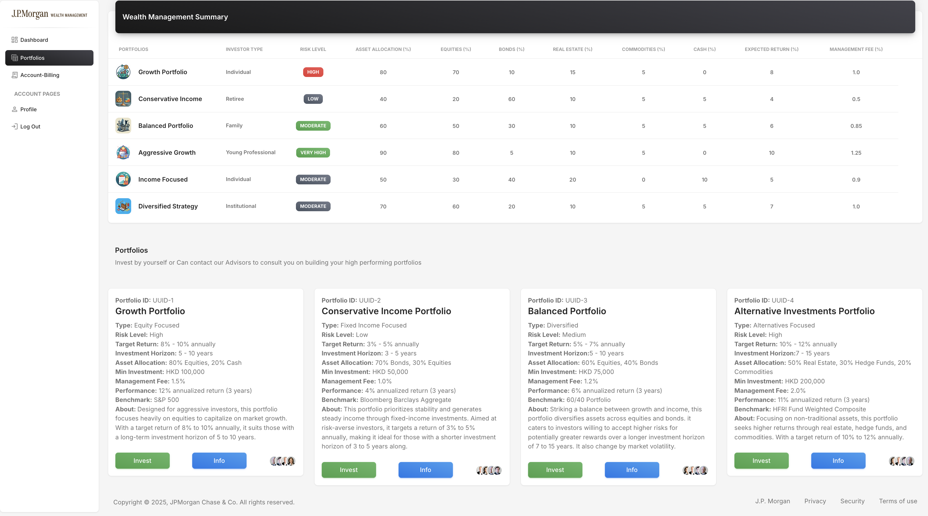
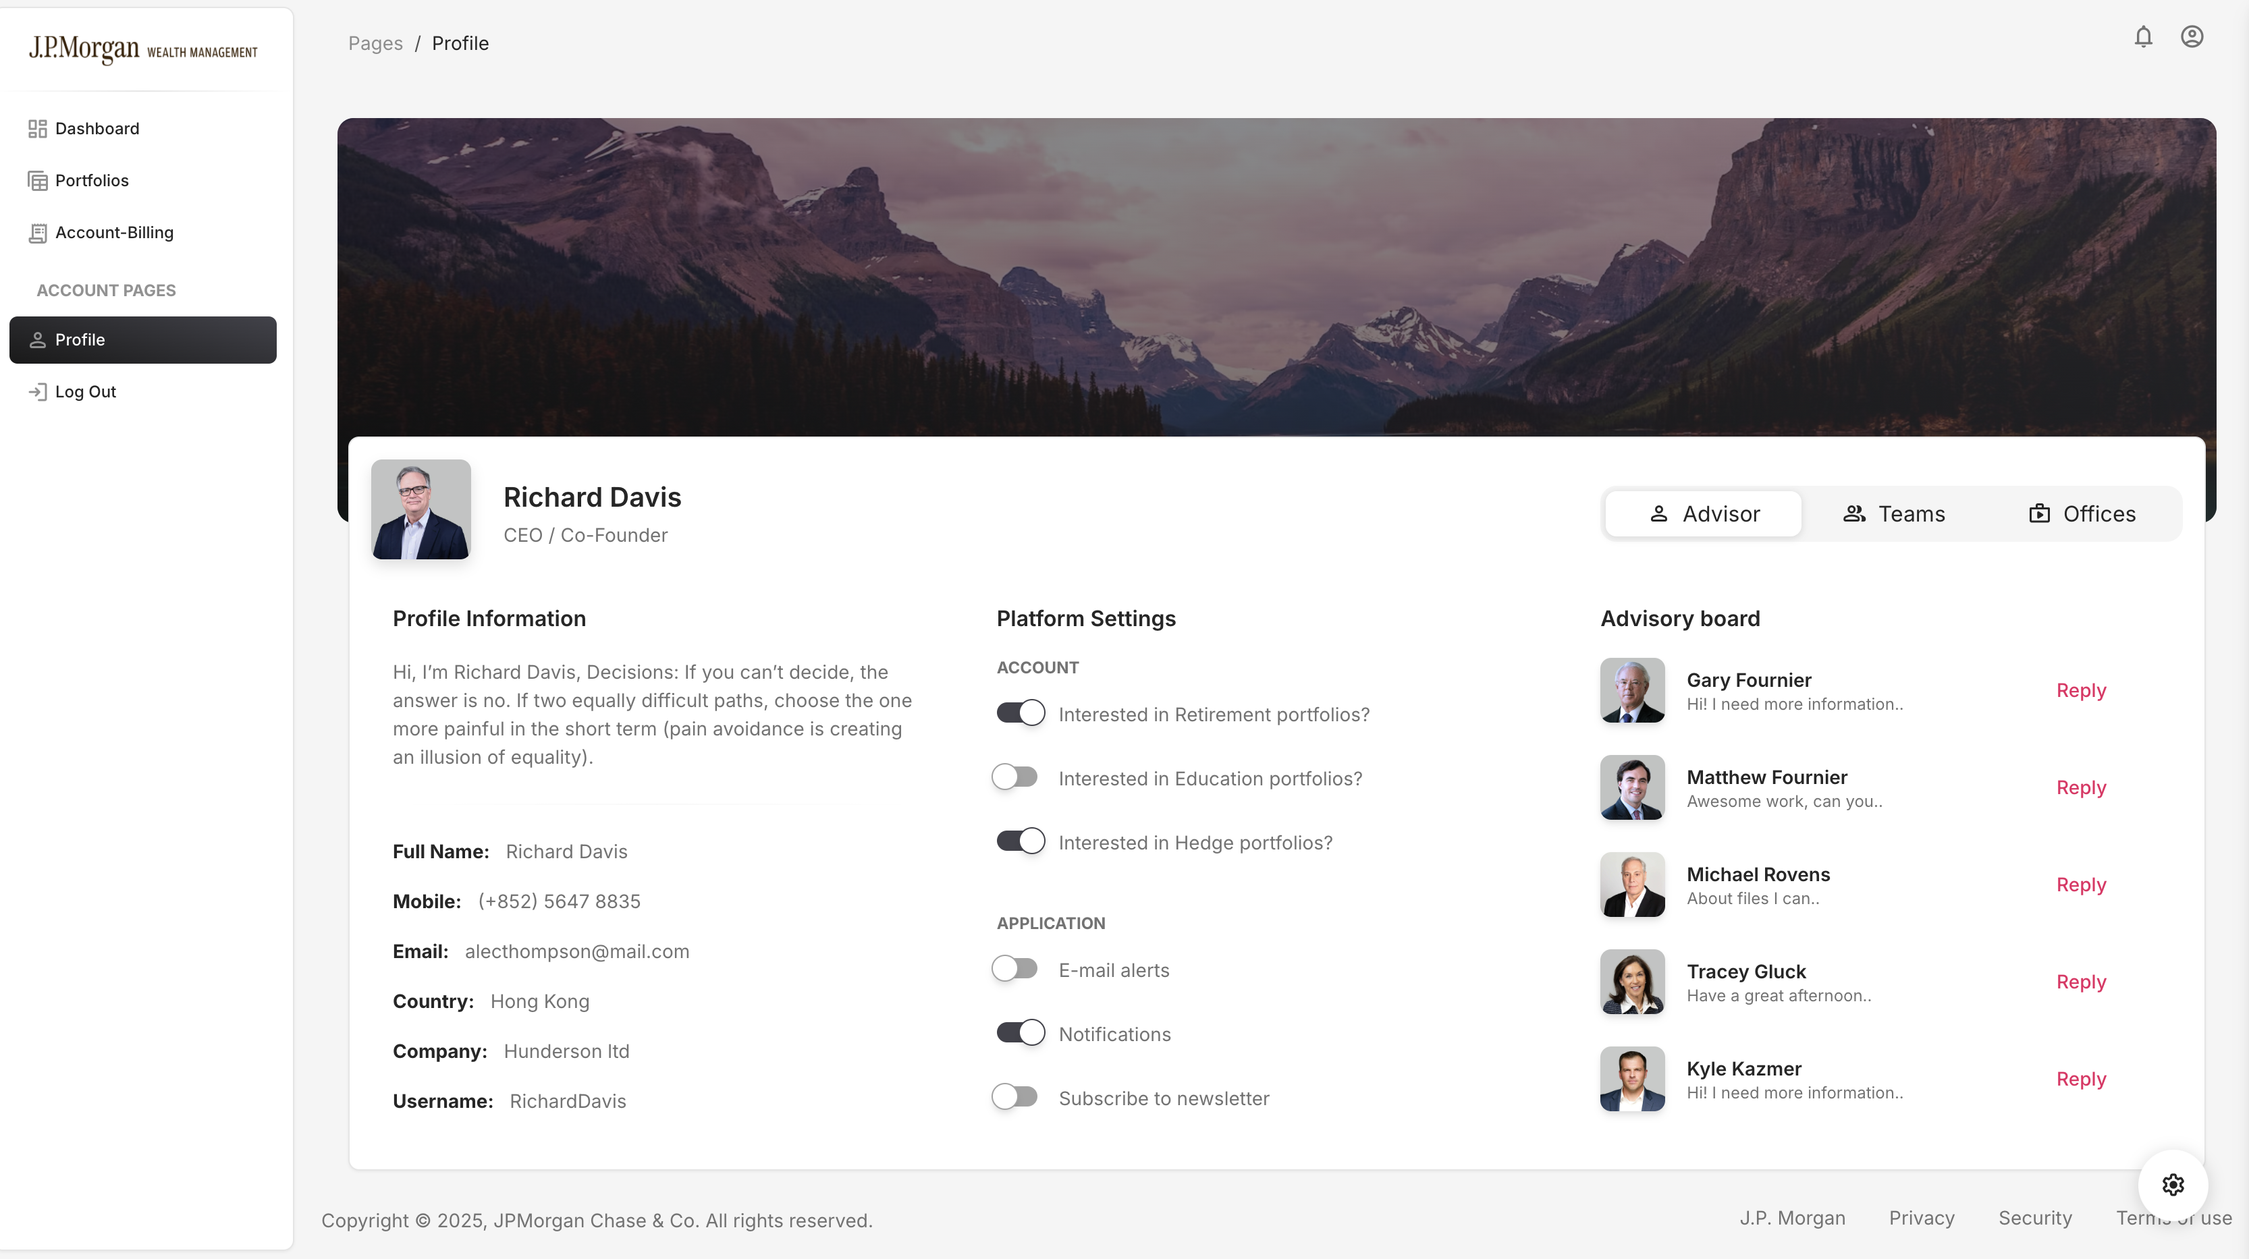
Demo:

Slide 10
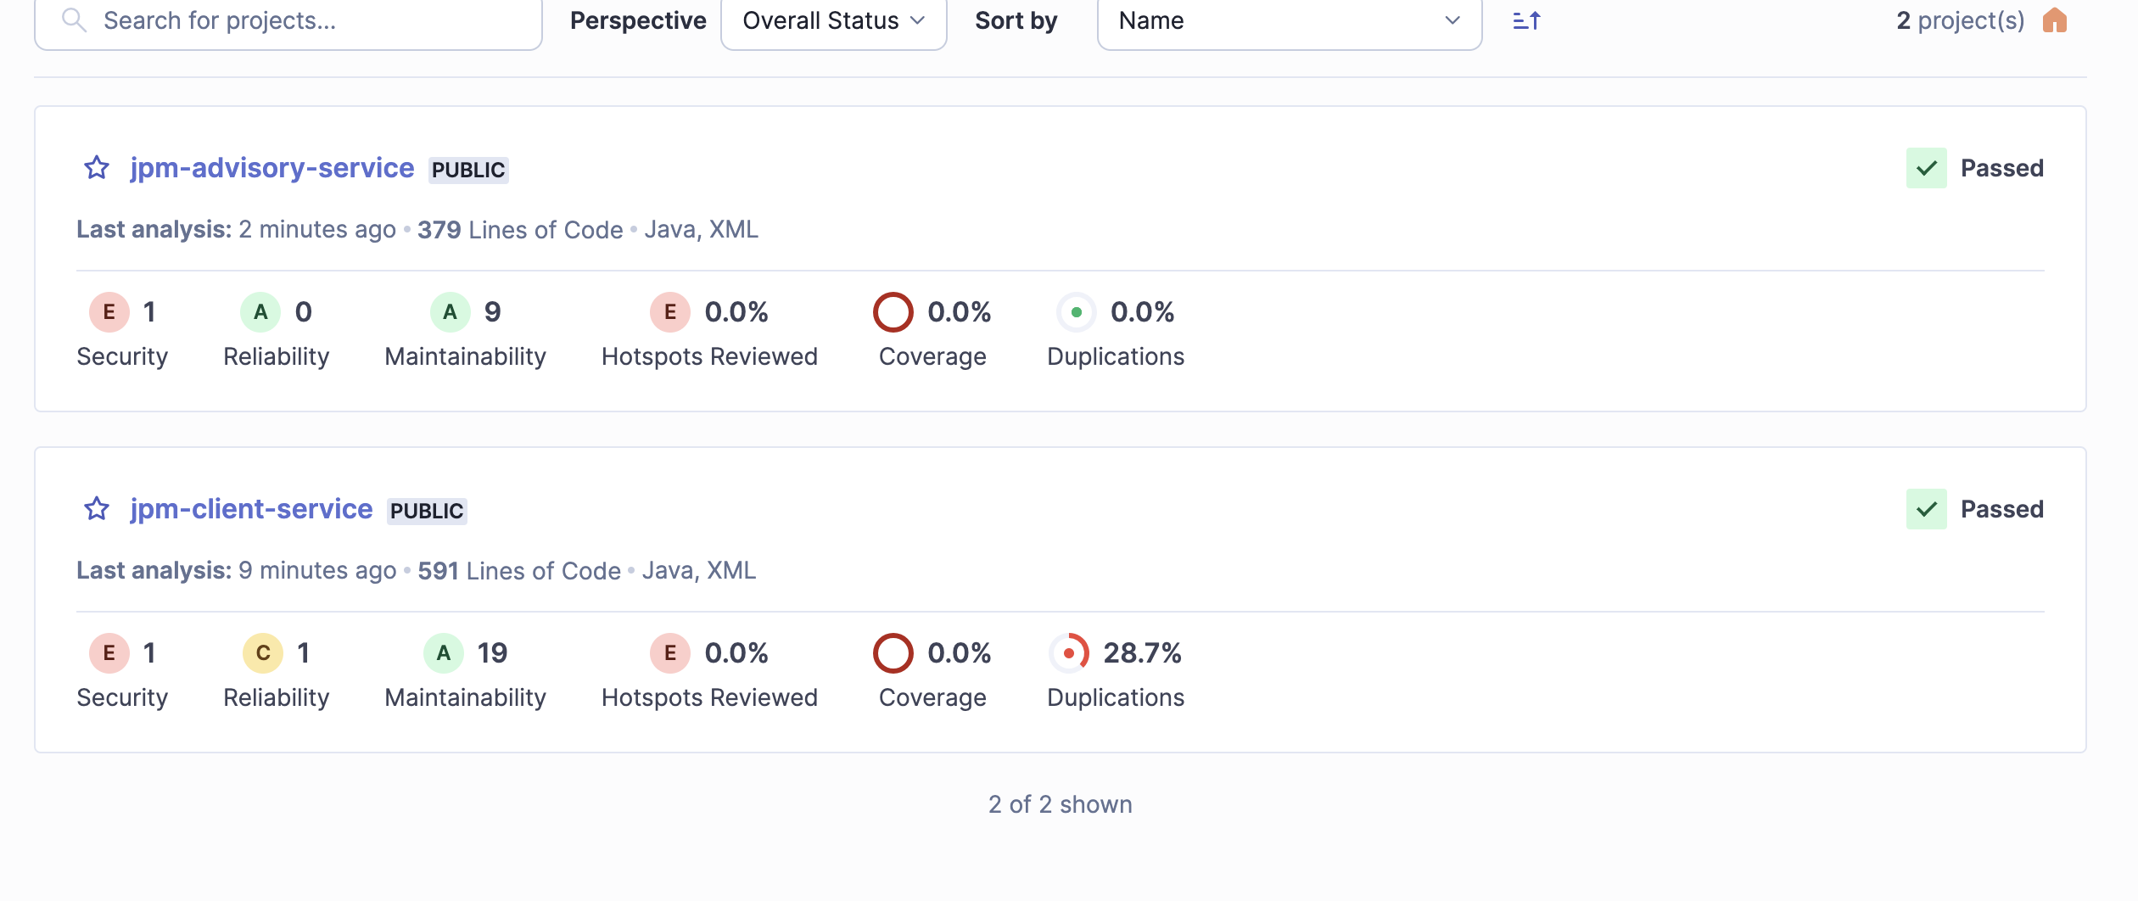
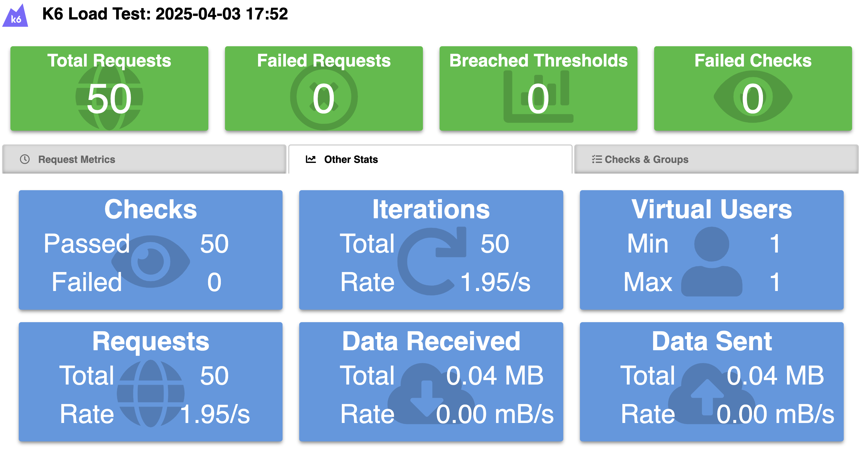
Reports

